Slide 2
Hard Times:
The need for pragmatic professional development
Prof. Ken Jones President, ipda

Slide 3
Our aims include
to support, develop and promote good professional
development practice;
to ... promote networks of individuals concerned with professional
development in education and training;
to liaise with other education and training groups both national and
international;

Slide 5
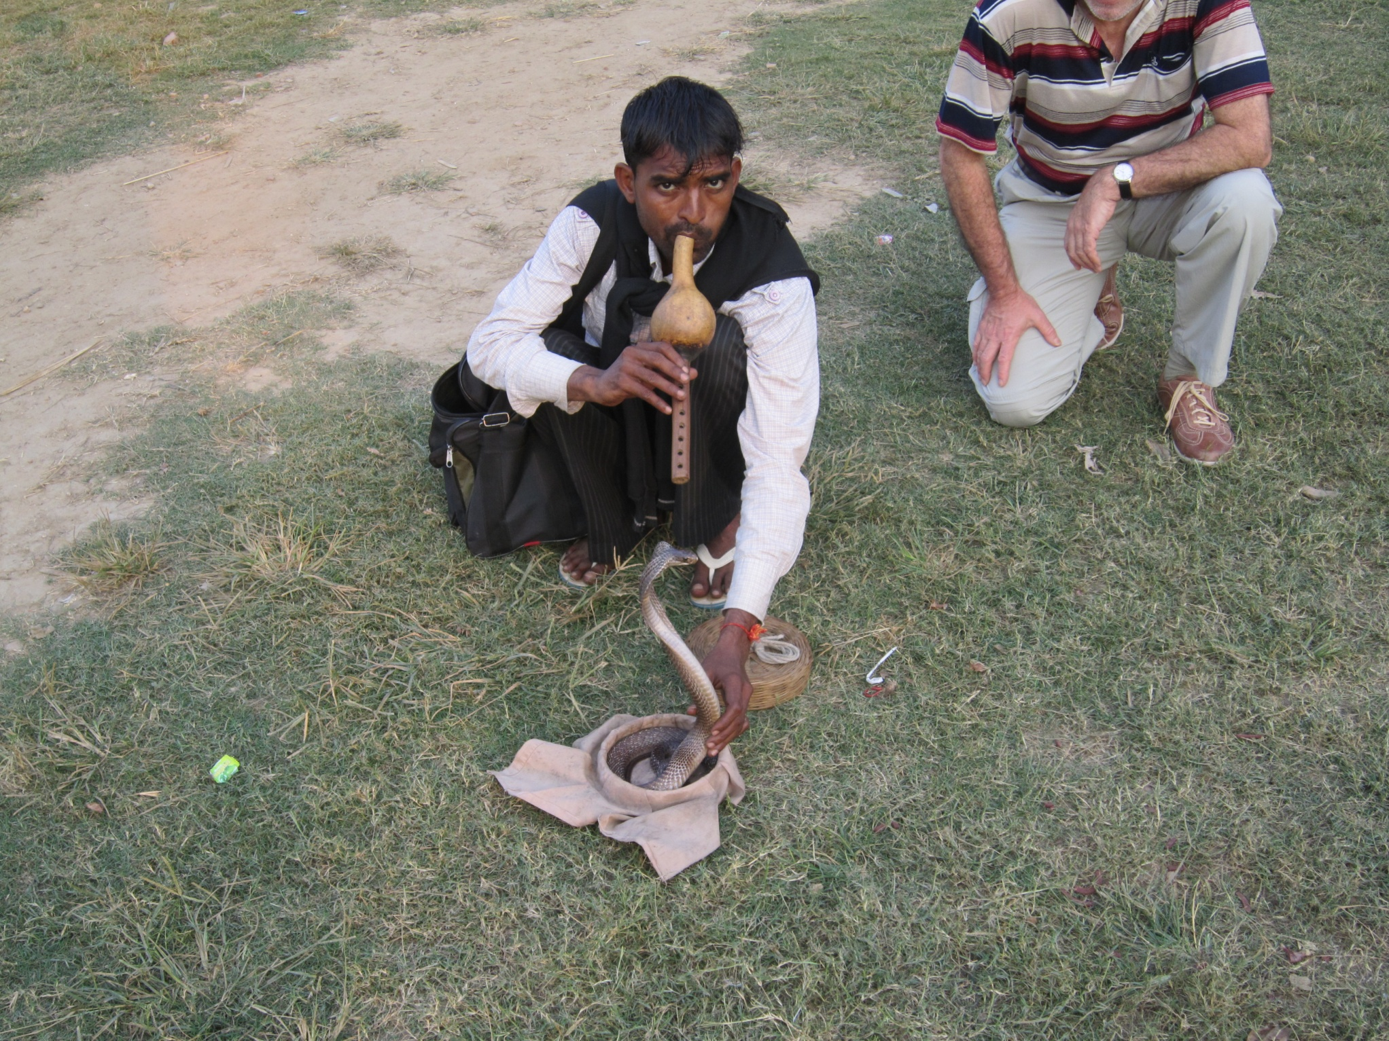

Slide 6
Hard Times:
The need for pragmatic professional development
Prof. Ken Jones President, ipda

Slide 7
the political element (this is how you must do it)
the professional element (this is how you should do it)
the pragmatic alternative (this is how we will do it)

Slide 8
the political element
(this is how you must do it)

Slide 9
‘We will reform Initial Teacher Training so that it focuses on what is really important ’ (p22)
The Importance of Teaching The Schools White Paper 2010
London: DfE

Slide 10
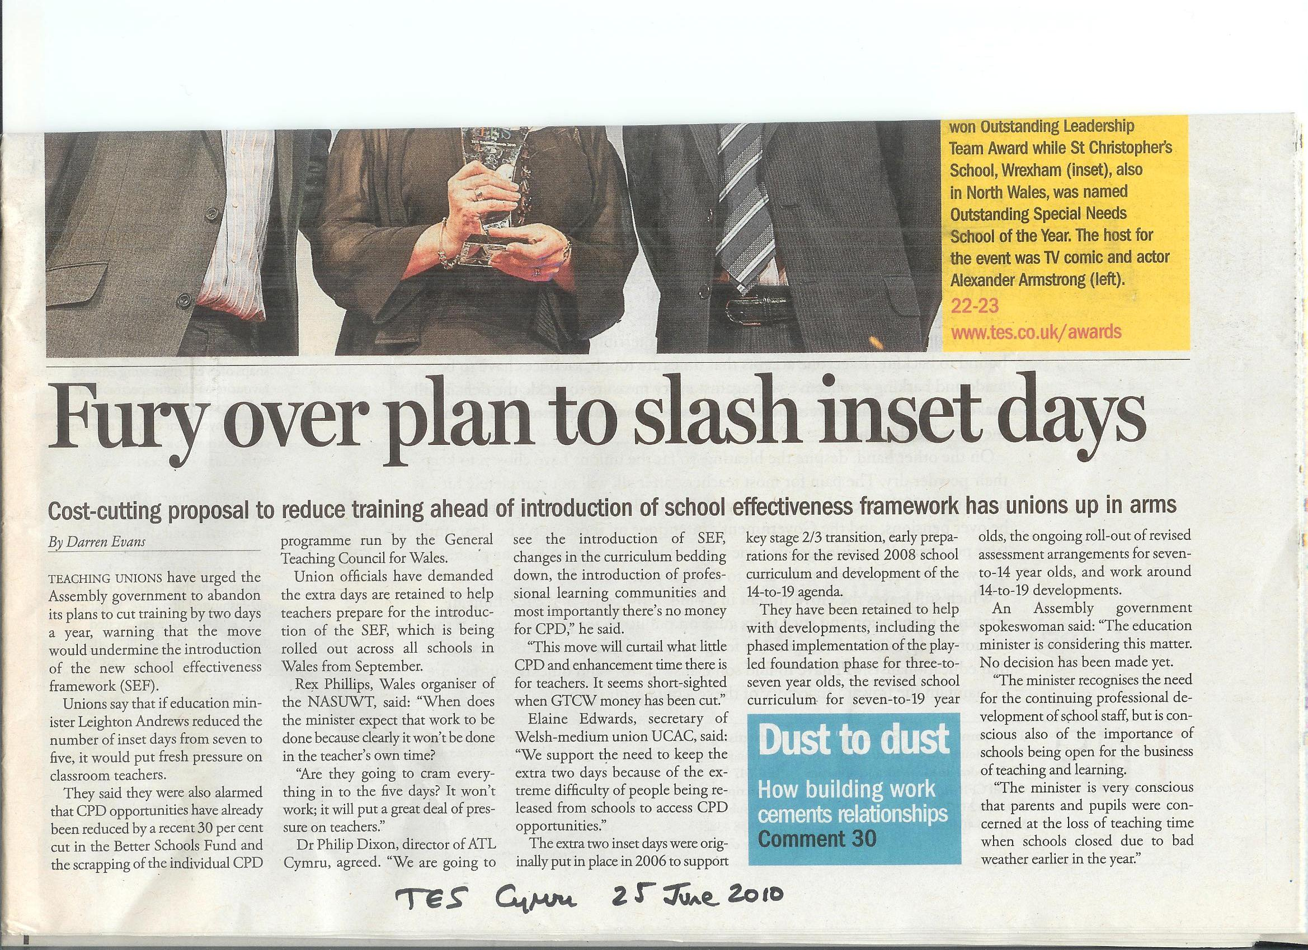

Slide 11
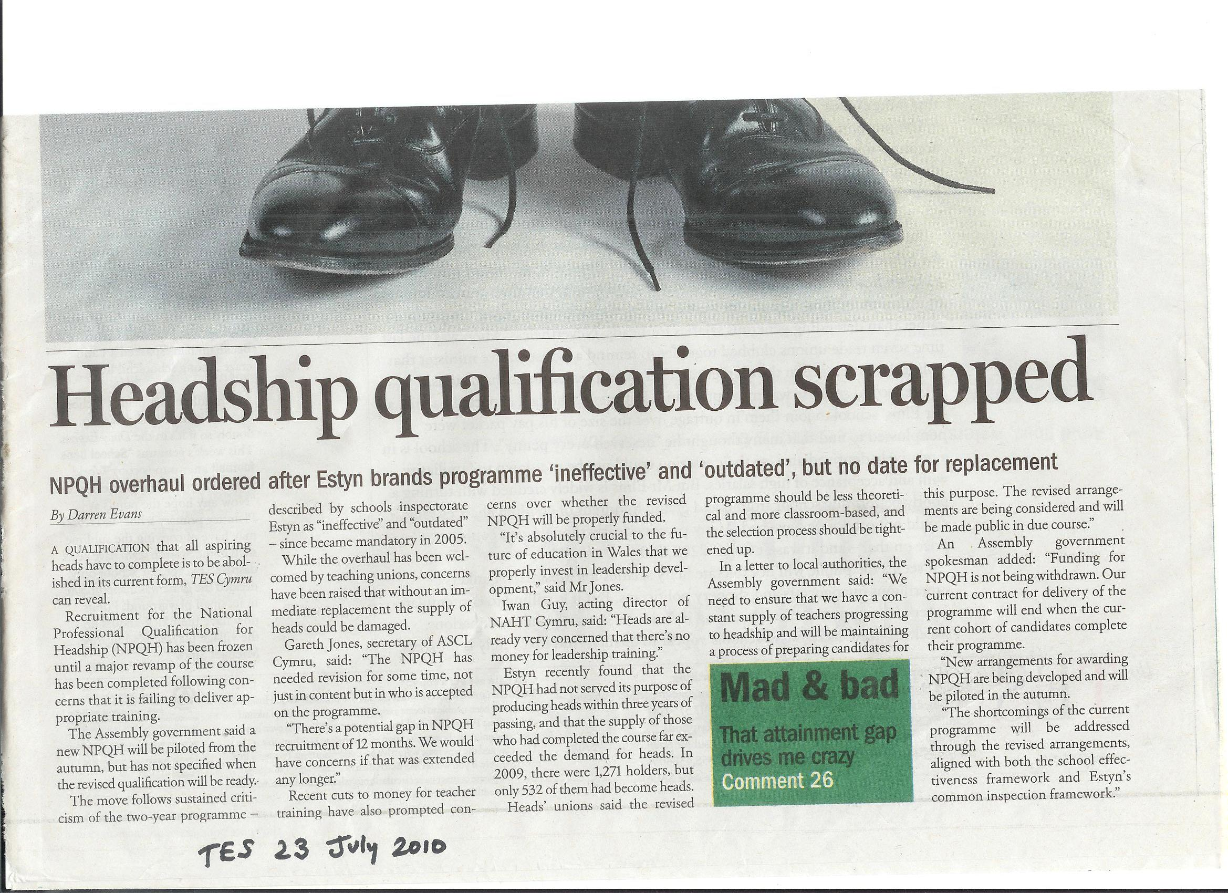

Slide 12
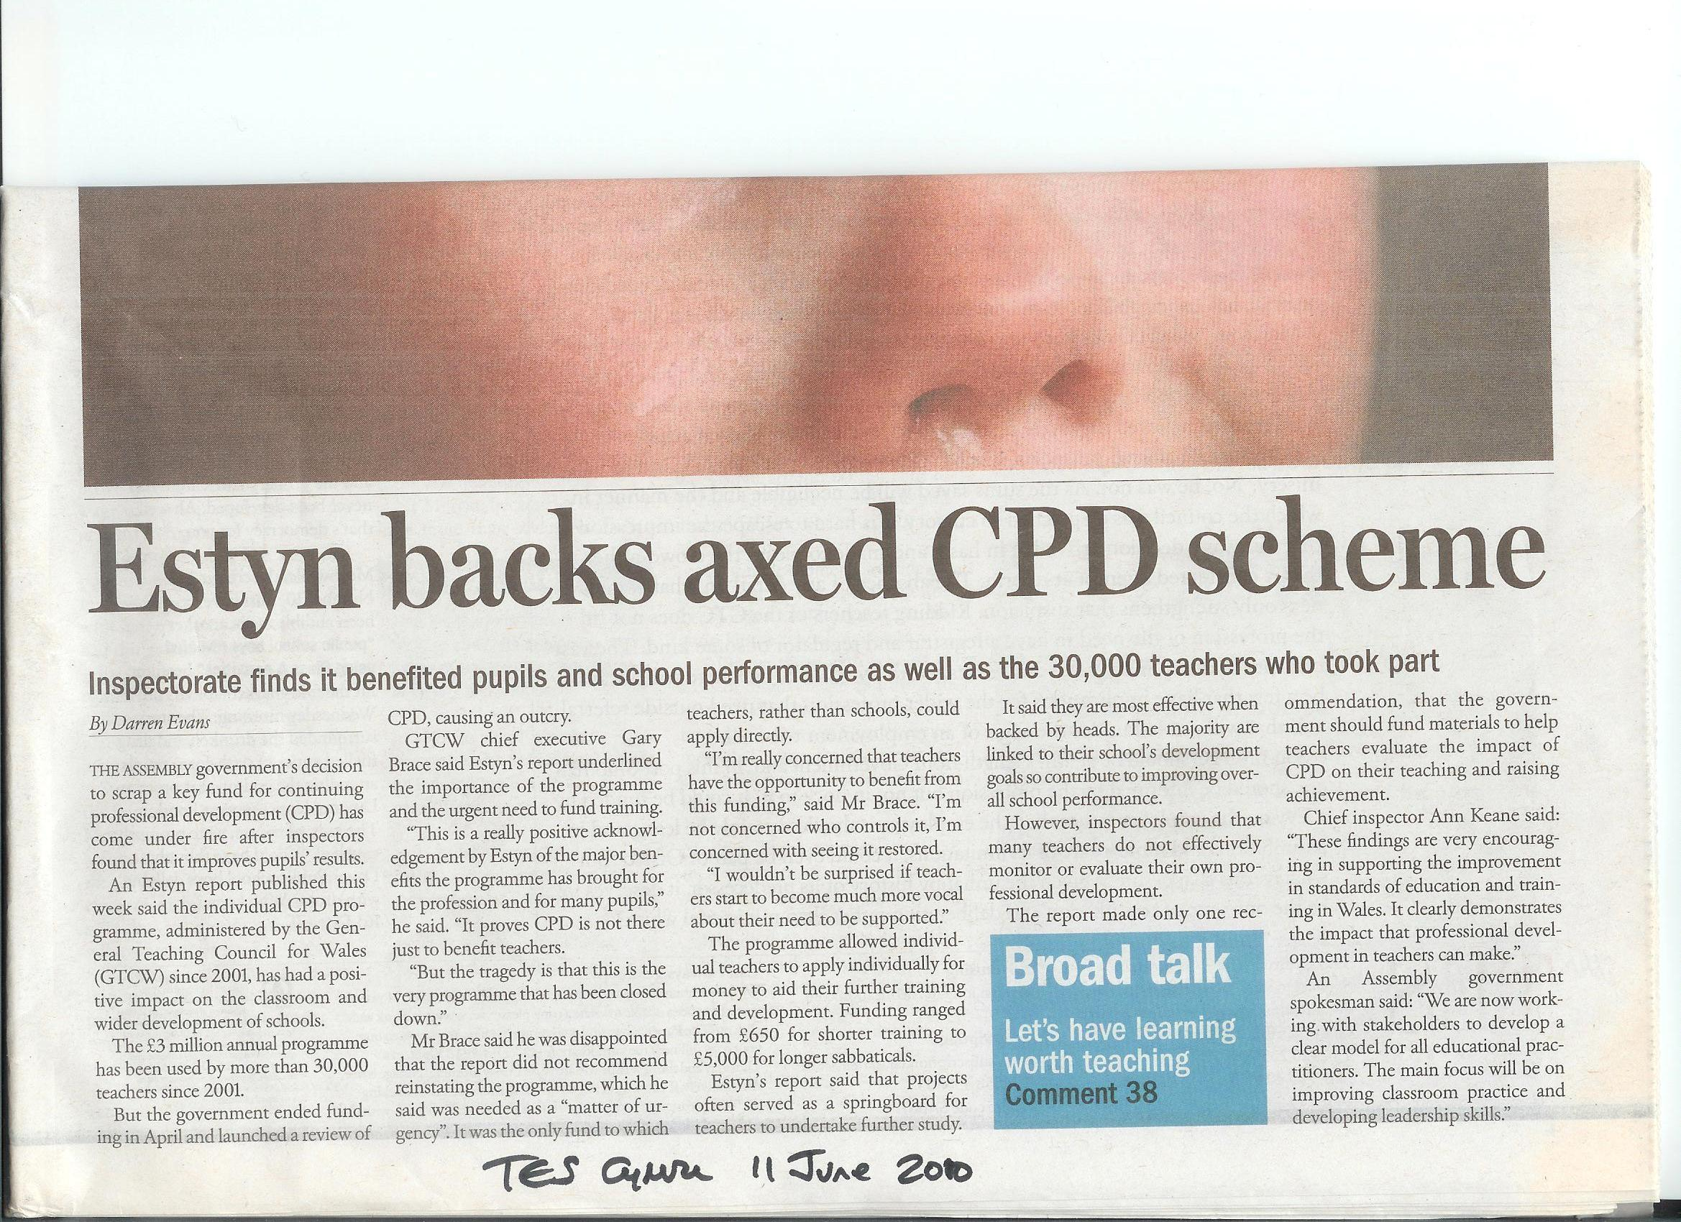

Slide 13
‘We will reform the National Professional Qualification for Headship ...
We are concerned that the qualification has been overly focused on how to implement government policy rather than on the key skills required for headship’
(para 2.38, p27).

Slide 14
the professional perspective
(this is how you should do it)

Slide 15
‘… underpinning much of [the professional development framework] is respect for the professional judgement and position of teachers. Recognising that teachers may have individual professional needs that may not always be the same as those of the school, local or central government is one illustration of such respect’
(Brace 2006)

Slide 16
‘We will make sure that teachers have support for their professional development’ (p24)
‘We will work to support the professional development of all teachers’ (para 2.27 p 24)
‘It is ... vital that we give teachers the opportunity to ... renew the passion which brought them into the classroom’ (para 2.28, p24)

Slide 17
‘‘We will work to support the professional development of all teachers’ (para 2.27 p 24)
‘So, from 2011 we will introduce a competitive national scholarship scheme to support professional development.
An independent panel will make awards to support those who wish to pursue further study in their subject or broaden their expertise’ (para 2.28, p24)

Slide 18
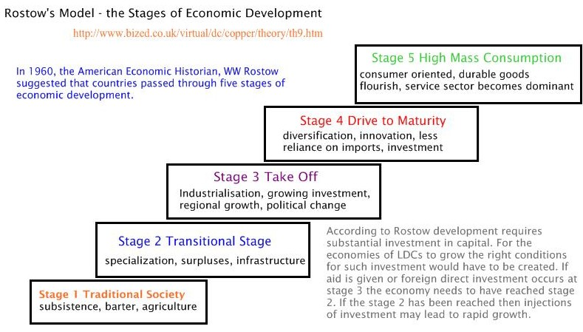

Slide 19
the pragmatic alternative
(this is how we will do it)

Slide 20
Implementation gap

Slide 21
Street level bureaucrats
‘… the decisions of street level bureaucrats, ... effectively become the public policies they carry out. … public policy is not best understood as made in ... top-floor suites of high-ranking administrators, ... it is actually made in the crowded offices and daily encounters of street-level workers.’ (p.389-390)
Lipsky (1971)

Slide 22
Ideally, and by training, street-level bureaucrats respond to the individual needs or characteristics of the people they serve or confront. In practice, they must deal with clients on a mass basis … Teachers should respond to the needs of the individual child; in practice they must develop techniques to respond to children as a class’
(Lipsky, 1971 p.390).

Slide 23
‘... it’s not the amount of time spent in the classroom that matters but what goes on in that time’

Slide 24
SMU MA (Ed) New Starts

Slide 25
‘ ... we will invite some of the best higher education providers of initial teacher training to open University Training Schools’. (para 2.25 p 23).

Slide 26
Fault lines
Teacher Educator academic
The contractual fault line
The linguistic fault line
The territorial fault line

Slide 27
‘The initial training of teachers is perhaps the most important part of their professional development ‘
(para 2.20 p 22)

Slide 28
A PDF for Teachers in Wales
CPD
EPD
IPP
Induct’n
Elements of CPD: alignment

Slide 29
Models of professional development (Kennedy, 2005)
Training model
Award bearing model
Deficit model
Cascade
Coaching/mentoring model
Community of practice model
Action research model
Transformative model

Slide 30
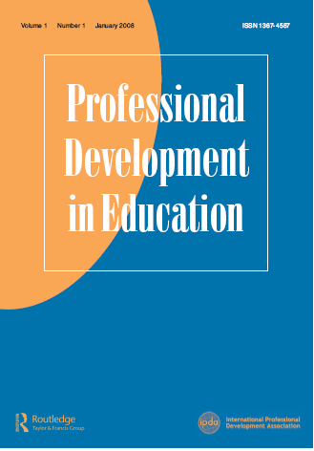
Website:
tandf.co.uk
Notes:
Task1 – who is responsible for CPD in your school (is there a staff development coordinator)?
What is their job title?
How is CPD funding allocated?
To what extent is CPD focused on pedagogy?
Are there any restrictions on CPD entitlement for teachers?
How effective is performance management in identifying and providing for your CPD needs?

Slide 31
‘To me education is a leading out of what is already there in the pupil’s soul.
To Miss Mackay it is a putting in of something that is not there, and that is not what I call education,
I call it intrusion’
Muriel Spark (1961) The Prime of Miss Jean Brodie

